Slide 1


8
Advanced
Collections
C# Programming: From Problem Analysis to Program Design
4th Edition

Slide 2
Chapter Objectives
Create two-dimensional arrays including rectangular and jagged types
Use multidimensional arrays
Use the ArrayList class to create dynamic lists
Learn about the predefined methods of the string class

Slide 3
Chapter Objectives (continued)
Be introduced to the other collection classes
Work through a programming example that illustrates the chapter’s concepts

Slide 4
Two-Dimensional Arrays
Two-dimensional and other multidimensional arrays follow same guidelines as one-dimensional
Two kinds of two-dimensional arrays
  Rectangular
    Visualized as a table divided into rows and columns
  Jagged or ragged
Referenced much like you reference a matrix

Slide 5
Two-Dimensional Arrays (continued)
int [ , ] calories = { {900, 750, 1020}, {300, 1000, 2700},
{500, 700, 2100}, {400, 900, 1780},
{600, 1200, 1100}, {575, 1150, 1900},
{600, 1020, 1700} };
Notice how each row is grouped using curly braces. A comma is used to separate rows
Values are stored side by side in contiguous memory locations using a row major format

Slide 6
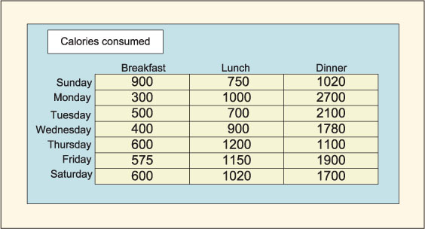
Two-Dimensional Representation
Figure 8-1 Two-dimensional structure

Slide 7
Two-Dimensional Arrays (continued)
Declaration format
  type [ , ] identifier = new type [integral value, integral value];
  Two integral values are required for a two-dimensional array
    Number of rows listed first
Data values placed in array must be of the same base type
Example (create a 7x3 matrix)
  int [ , ] calories = new int[7, 3];

Slide 8
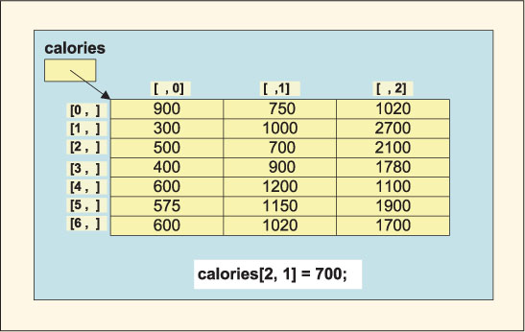
Two-Dimensional Arrays (continued)
calories references address of calories[0,0]
Figure 8-2 Two-dimensional calories array

Slide 9
Two-Dimensional Arrays (continued)
Length property gets total number of elements in all dimensions
  Console.WriteLine(calories.Length); // Returns 21
GetLength( ) – returns the number of rows or columns
  GetLength(0) returns number of rows
  GetLength(1) returns number of columns
    Console.WriteLine(calories.GetLength(1)); //Display 3 (columns)
    Console.WriteLine(calories.GetLength(0)); //Display 7 (rows)
    Console.WriteLine(calories.Rank); // returns 2 (dimensions)

Slide 10
Two-Dimensional Arrays (continued)
  int [ , ] calories = new int[7, 3];
  Console.WriteLine(calories.GetUpperBound(0)); // Returns 6 (row index)
foreach (int cal in calories) // Displays all values
Console.Write(cal + " ");
for (int r = 0; r < calories.GetLength(0); r++)
for (int c = 0; c < calories.GetLength(1); c++)
calories[r, c] = 0; // Initializes all cells

Slide 11
Two-Dimensional Arrays (continued)
public static double[ ] CalculateAverageByDay (int[ , ] calories)
{
int sum = 0;
double[ ] dailyAverage = new double[7];
for (int r = 0; r < calories.GetLength(0); r++)
{
for (int c = 0; c < calories.GetLength(1); c++)
sum += calories[r, c];
dailyAverage[r] = (double)sum / calories.GetLength(1);
sum = 0;
}
return dailyAverage;
}
Method returns array of averages…row averages

Slide 12
Two-Dimensional Arrays (continued)
public static double[ ] CalculateAverageByMeal(int[ , ] calories)
{
int sum = 0;
double[ ] mealAverage = new double[3];
for (int c = 0; c < calories.GetLength(1); c++)
{
for (int r = 0; r < calories.GetLength(0); r++)
sum += calories[r, c];
mealAverage[c] = (double)sum / calories.GetLength(0);
sum = 0;
}
return mealAverage;
}
Method returns array of averages…col averages

Slide 13
Two-Dimensional Arrays (continued)
public static void DisplayAverageCaloriesPerMeal (int[ , ] calories)
{
double sum = 0;
for (int da = 0; da < calories.GetLength(0); da++)
for (int ml = 0; ml < calories.GetLength(1); ml++)
sum += calories[da, ml];
Console.WriteLine("\nCaloric Average Per Meal: {0:N0}",
sum / calories.Length);
}
da and ml used as row/col identifiers →more representative of the data
Review WeeklyCalorieCounter Example

Slide 14
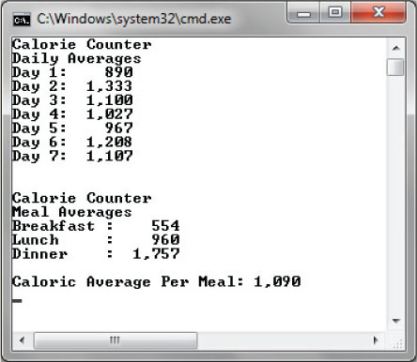
Two-Dimensional Arrays (continued)
Figure 8-3 Output from WeeklyCalorieCounter

Slide 15
Two-Dimensional Arrays (continued)
To align numbers for output, format specifier used
  Console.WriteLine("{0,-10}: {1,6}", mealTime[c ],
  mealAverage[c ].ToString("N0"));
  Comma separates placeholder index from width specifier
  First argument ({0,-10}) indicates that the first argument should be displayed in a width of 10
  Negative value in front of the 10 indicates the value should be left justified
  Second argument ({1,6}) indicates the numbers are right justified in a width of 6 character positions

Slide 16
Jagged Arrays
Rectangular arrays always have a rectangular shape, like a table; jagged arrays do not
Also called ‘arrays of arrays’
Example
    int[ ] [ ] anArray = new int[4] [ ];
    anArray [0] = new int[ ] {100, 200};
    anArray [1] = new int[ ] {11, 22, 37};
    anArray [2] = new int[ ] {16, 72, 83, 99, 106};
    anArray [3] = new int[ ] {1, 2, 3, 4};

Slide 17
Multidimensional Arrays
Limited only by your imagination as far as the number of dimensions
Format for creating three-dimensional array
    type [ , , ] identifier =
    new type [integral value, integral value, integral value];
Example (rectangular)
    int [ , , ] calories = new int [4 ,7 ,3];
    (4 week; 7 days; 3 meals)
Allocates storage for 84 elements

Slide 18
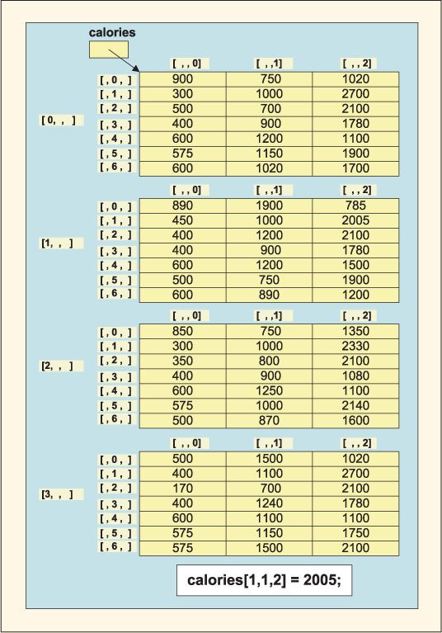
Multidimensional Arrays (continued)
Figure 8-4 Three-dimensional array
Upper bounds on the indexes are 3, 6, 2

Slide 19
Multidimensional Arrays (continued)
int [ , , ] calories = new int [4, 7, 4];
// Loop to place the row total in the last column, indexed by 3
for (int wk = 0; wk < calories.GetLength(0); wk++)
{
for (int da = 0; da < calories.GetLength(1); da++)
{
for (int ml = 0; ml < calories.GetLength(2) - 1; ml++)
{
calories[wk, da, 3] += calories[wk, da, ml];
}
}
}
Review CalorieCounter Example

Slide 20
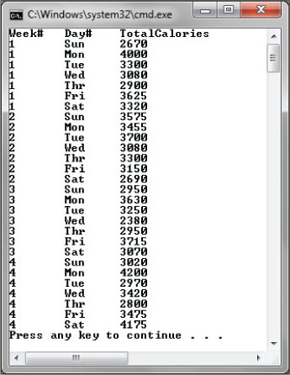
Multidimensional Arrays (continued)
Index from the calories array for the day
number used as index for the string day name array

Slide 21
ArrayList Class
Limitations of traditional array
  Cannot change the size or length of an array after it is created
ArrayList class facilitates creating listlike structure, AND it can dynamically increase or decrease in length
  Similar to vector class found in other languages
Includes large number of predefined methods

Slide 22
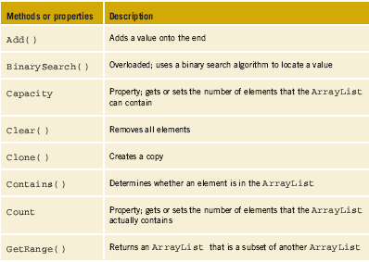
ArrayList Class (continued)
Table 8-1 ArrayList members

Slide 23
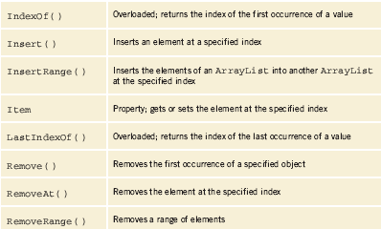
ArrayList Class (continued)
Table 8-1 ArrayList members (continued)

Slide 24
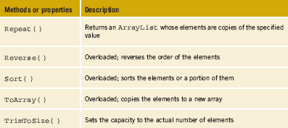
ArrayList Class (continued)
Table 8-1 ArrayList members (continued)

Slide 25
ArrayList Class (continued)
Any predefined or user-defined type can be used as an ArrayList object
C# also includes a List<> class
  List<> class requires that objects be the same type when you place them in the structure
  ArrayList allows you to mix types

Slide 26
ArrayList Class (continued)
ArrayList anArray = new ArrayList( ); // Instantiates ArrayList
anArray.Add("Today is the first day of the rest of your life!");
anArray.Add("Live it to the fullest!"); anArray.Add("ok");
anArray.Add("You may not get a second chance.");
anArray.RemoveAt(2); // Removes the third physical one
for (int i = 0; i < ar.Count; i++) //Displays elements
Console.WriteLine(ar[i] );

Slide 27
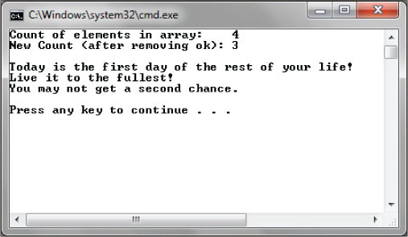
ArrayList Class (continued)
Figure 8-6 Sample run from the ArrayList example
Review ArrayListExample

Slide 28
String Class
Stores a collection of Unicode characters
Immutable series of characters
Reference type
  Normally equality operators, == and !=, compare the object’s references, but operators function differently with string than with other reference objects
    Equality operators are defined to compare the contents or values
Includes large number of predefined methods

Slide 29
String Class
Can process variables of string type as a group of characters
  Can also access individual characters in string using an index with [ ]
    First character is indexed by zero
string sValue = "C# Programming";
object sObj;
string s = "C#";
The declarations used with Examples in Table 8-2 on next slide

Slide 30
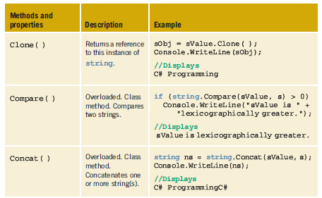
Table 8-2 Members of the string class

Slide 31
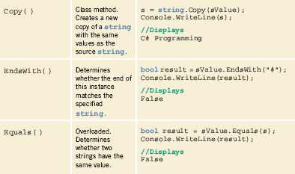
Table 8-2 Members of the string class (continued)

Slide 32
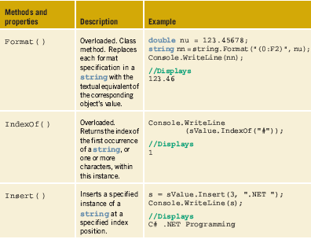
Table 8-2 Members of the string class (continued)

Slide 33
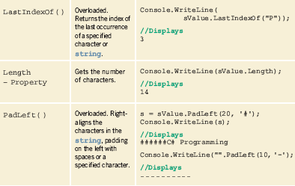
Table 8-2 Members of the string class (continued)

Slide 34
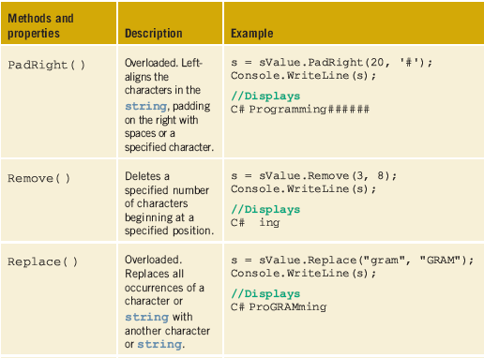
Table 8-2 Members of the string class (continued)

Slide 35
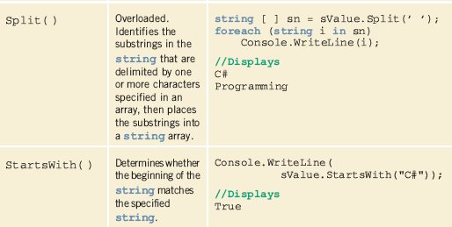
Table 8-2 Members of the string class (continued)

Slide 36
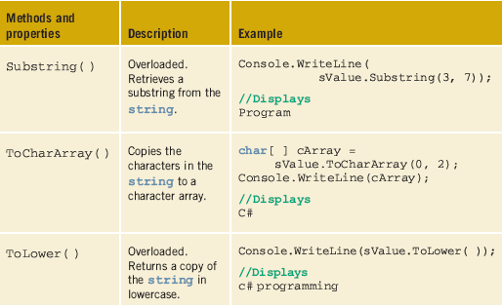
Table 8-2 Members of the string class (continued)

Slide 37
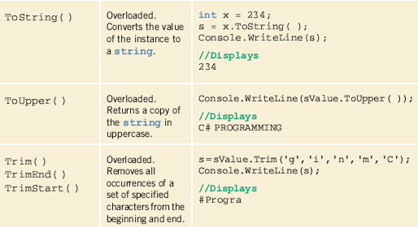
Table 8-2 Members of the string class (continued)

Slide 38
String Class
Class methods, such as Compare, Concat, and Copy, prefix the name of the method in the call with the string data type (e.g. s = string.Copy(sValue);).
Most string member arguments that take a string object accept a string literal
  @-quoted string literals, start with the @ symbol
      Console.WriteLine(@"hello \t world");
      //Displays hello \t world

Slide 39
Other Collection Classes
Collection classes are classes that enable you to store and retrieve various groups of objects
Number of other predefined collection classes
  Classes for storing bit values, creating stacks, queues, and hash tables

Slide 40
BitArray class
Bit values are represented as Booleans
Include the System.Collections namespace
  // Creates and initializes several BitArrays
  BitArray firstBitArr = new BitArray(10);
  BitArray secondBitArr = new BitArray(10, true);
  bool[ ] boolArray = new bool[5] {true, false, true, true, false};
  BitArray thirdBitArr = new BitArray(boolArray);
Count and Length properties
Item property

Slide 41
BitArray class (continued)
Set( ) and SetAll ( ) methods
BitArrays most commonly used to represent a simple group of Boolean flags
BitArrays useful for working with large data sets

Slide 42
HashTable class
Hashtable represents a collection of key/value pairs that are organized based on the hash code of the key
  Hash code - a number generated using a key with the objective of providing efficient insertion and find operations
    Overriding goal is to design an algorithm that provides as few collisions as possible
  Do not have to create your own algorithm when you use the .NET Hashtable class

Slide 43
HashTable class (continued)
  // Creates a new hash table
  Hashtable executableProgram = new Hashtable();
  // Add some elements to the hash table. There are no
  // duplicate keys, but some of the values are duplicates.
  executableProgram.Add("pdf", "acrord32.exe");
  executableProgram.Add("tif", "snagit32.exe");
  executableProgram Add("jpg", "snagit32.exe");
  executableProgram.Add("sln", "devenv.exe");
  executableProgram.Add("rtf", "wordpad.exe");

Slide 44
HashTable class (continued)
To write your own hash algorithm, override the GetHashCode( ) method and provide a new algorithm for the hash function
  Should also override the Equals( ) method to guarantee that two objects considered equal have the same hash code
Has properties and methods of Add( ), Clear( ), Contains( ), Count, Keys, Item, Remove( ), and Values

Slide 45
Linked List
Linked lists have additional field that contains a reference (link) to next record in the sequence
  Records do not have to be physically stored beside each other to retain their order
    Enables insertion and removal of records at any point in the list
  Insertion involves adjustment of links to point to newly inserted element
  Deletion involves adjustment of links to not point to deleted node

Slide 46
Queue
First-In-First-Out (FIFO) collection of objects
Useful for storing objects in the order they were received for sequential processing
Capacity of a queue is the number of elements the queue can hold
Enqueue( ) adds an object to the end of the queue
Dequeue( ) removes and returns object at the beginning of the queue

Slide 47
Stack
Last-in-first-out (LIFO) collection of objects
As elements are added, the capacity is automatically increased
Push( ) adds an object to the end of the stack
Pop( ) removes and returns the object to the beginning of the stack
Peak( ) returns the object at the beginning of the stack without removing it
  Queue also has a Peak( ) method
Review StackExample

Slide 48
Other Collection Classes
Dictionary - has much of the same functionality as the Hashtable class
Generic class that provides a mapping from a set of keys to a set of values
Add( ) method
Item property
Reference and retrieve values from the collection using its Keys and Values properties

Slide 49
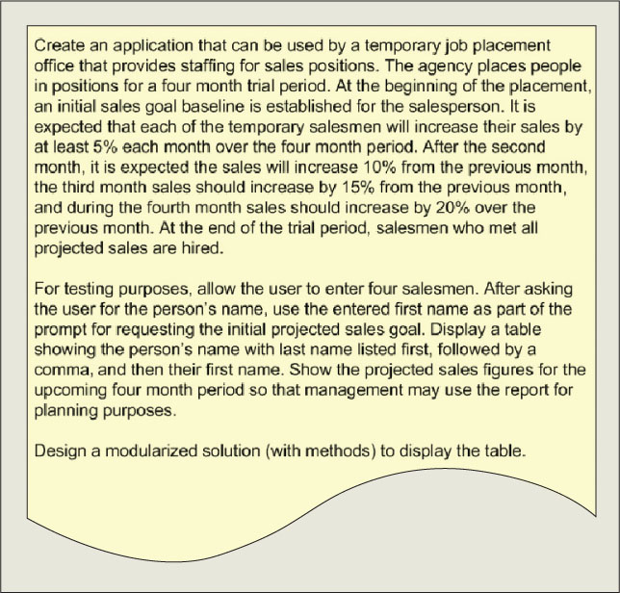
TempAgency Application Example
Figure 8-8 Problem specification for Manatee example

Slide 50
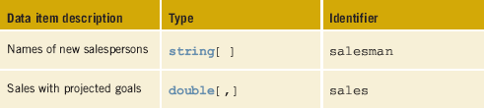
TempAgency Application Example (continued)
Table 8-3 Instance field members for the TempAgency class

Slide 51
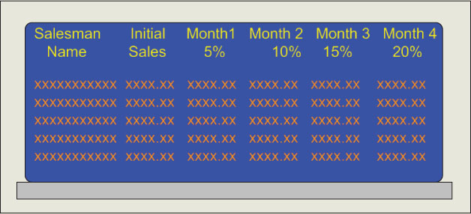
TempAgency Application Example (continued)
Figure 8-9 Prototype

Slide 52
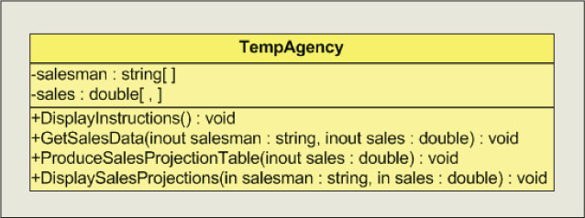
TempAgency Application Example (continued)
Figure 8-10 Class diagrams

Slide 53
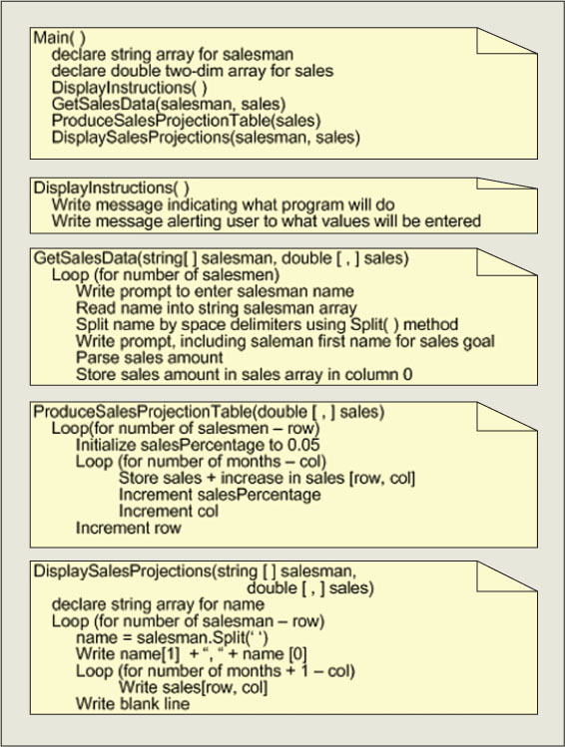
TempAgency Application Example (continued)
Figure 8-11 TempAgency
class methods behavior

Slide 54
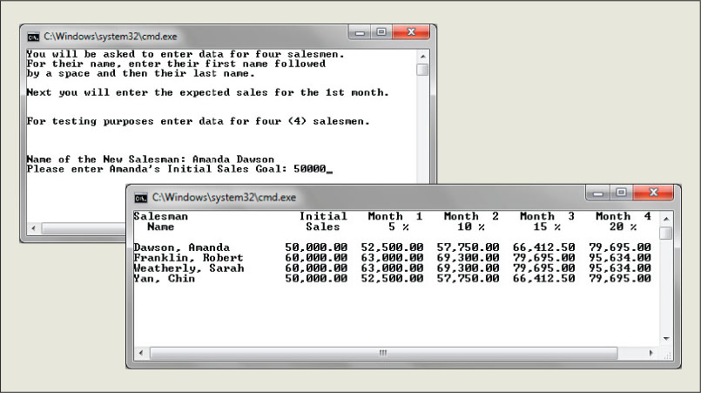
TempAgency Application Example (continued)
Figure 8-12 TempAgency application output
Review TempAgency Example

Slide 55
Coding Standards
Guidelines for Naming Collections
  Singular noun
  Camel case
Advanced Array Suggestions

Slide 56
Resources
An Extensive Examination of Data Structures –
http://msdn.microsoft.com/en-us/library/aa289148(VS.71).aspx
MSDN C# Data Structures series –
http://www.andrewconnell.com/blog/archive/2004/02/17/262.aspx
C# String Tutorial –
http://csharp.net-informations.com/string/csharp_string_tutorial.htm
Multidimensional Arrays –
http://www.functionx.com/csharp/Lesson23.htm

Slide 57
Chapter Summary
Multidimensional array declaration
  Compile-time initialization
  Accessing elements
ArrayList class members
String class members
Other Collection classes
  BitArray
  HashTable
  Queue
  Stack

